Slide 1
Today’s Topic
Similarity Measure
Jacard similarity
The Kullback-Leibler Distance
Hashing

Slide 2
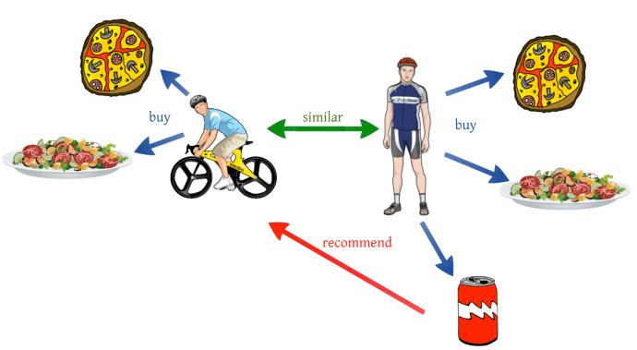
Similarity Measure
It’s a way of measuring how two data points are related or close to each other.
Smaller Distance, High Similarity
Application
Recommeder System
Clustering

Slide 3

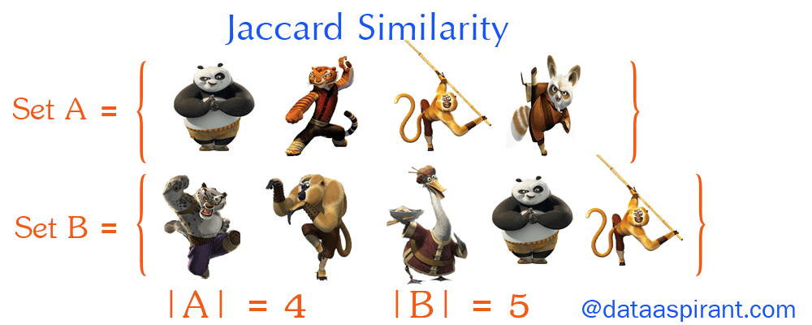
Jaccard similarity
Its measure the similarity between two sets via following Formula.
EXAMPLE

Slide 4
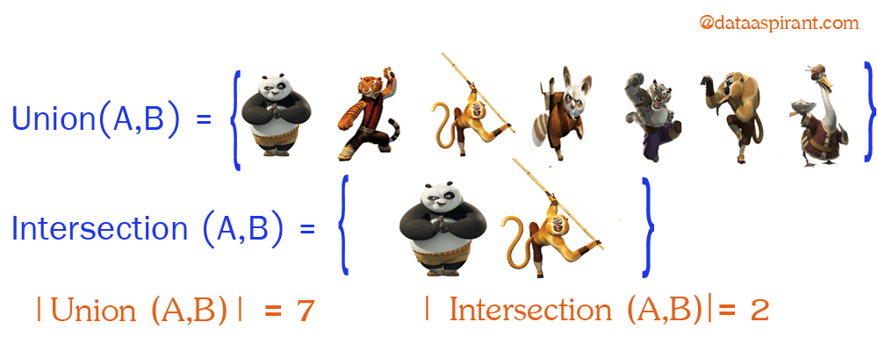
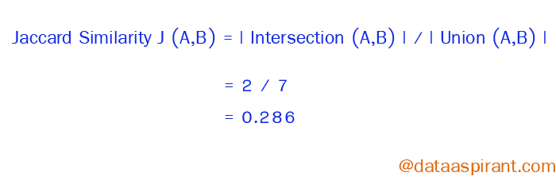

Slide 5
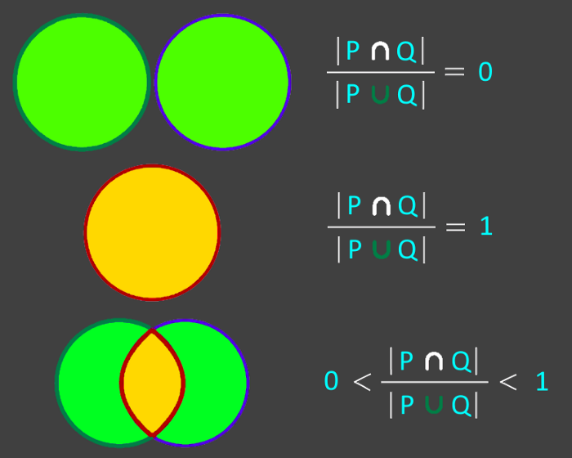

Slide 6

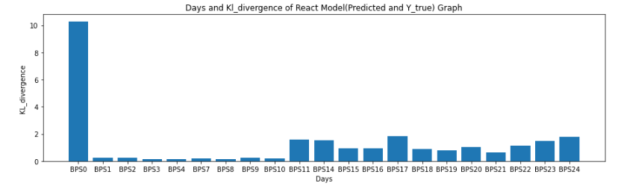
Kullback-Leibler divergence
Use to measure the difference between two probability distributions.

Slide 7
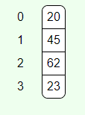
Hashing
The goal is to compute the Jaccard similarity without doing compution like union or intersection.
Hash position or index = Input Value % Table Size
20 % 4 = 0
45 % 4 = 1
23 % 4 = 3
62 % 4 = 2
https://iswsa.acm.org/mphf/openDSAPerfectHashAnimation/perfectHashAV.html
https://www.cs.usfca.edu/~galles/visualization/OpenHash.html

